Slide 1
Faculty Interfolio Information Session
Loyola University Chicago
May 1, 2024

Slide 2
Introductions
Michelle Pencyla, M.Ed.
Assistant Provost, Faculty Administration, Health Sciences Campus Office mpencyla@luc.edu
Julia Elsky, Ph.D.
Associate Director of Faculty Affairs;
Associate Professor, Department of Modern Languages & Literatures
jelsky@luc.edu or for Interfolio matters interfolio@luc.edu

Slide 3
Walk Through of Interfolio RPT
• Introducing Interfolio RPT
• How to access Interfolio RPT and upload materials
• Tips for organizing and uploading your materials
• Q & A

Slide 4
What is Interfolio RPT?
• Online tool for faculty under review to tell their story
• Enable committees to conduct efficient, fair digital evaluations of faculty
• Provide academic leadership with a consistent source of reliable information about all faculty evaluations
• Please note that Interfolio RPT is separate from F180 (faculty annual review).
• Faculty Affairs will request in late Spring/early Summer that Schools/College send names of faculty who are applying for tenure and/or promotion. Once we receive those names, we will create Interfolio RPT cases for faculty and notify faculty directly via Interfolio RPT. (The timing of this process corresponds with your College/School's P& T timeline.)

Slide 5
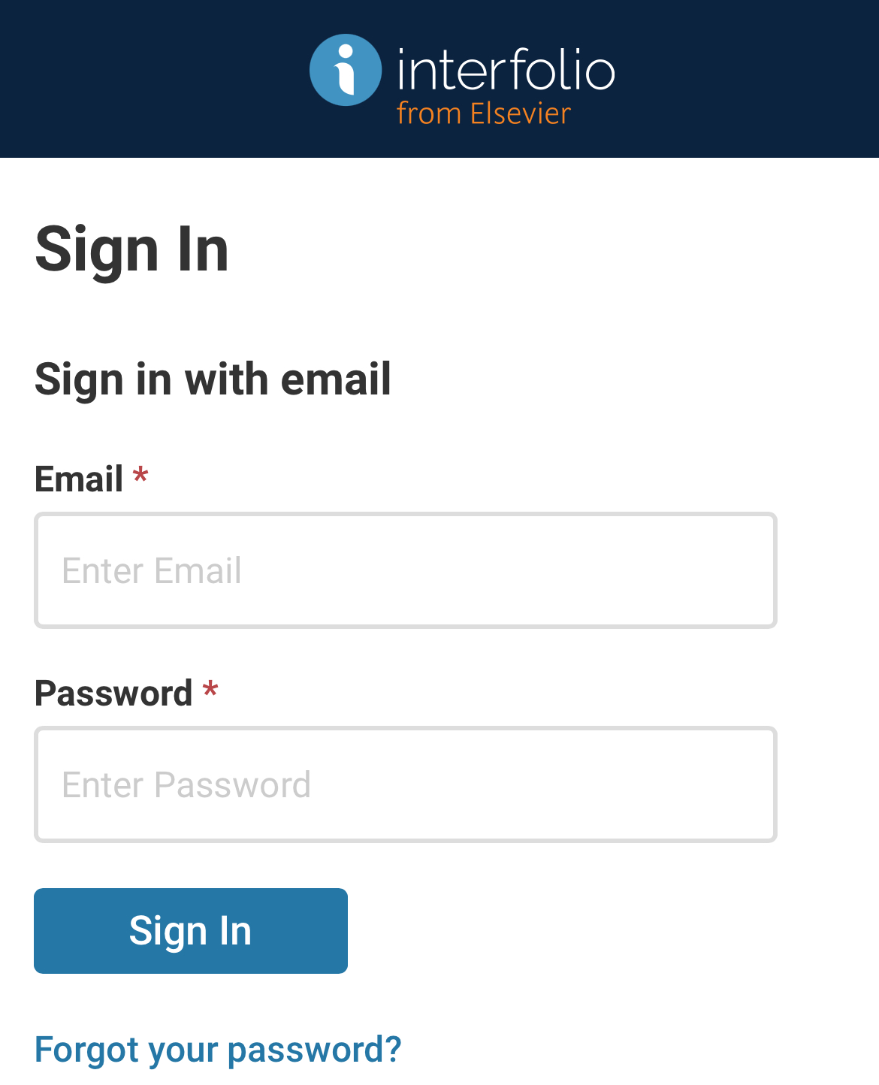
Step 1. Log into Interfolio RPT when you receive an email from the system

Slide 6
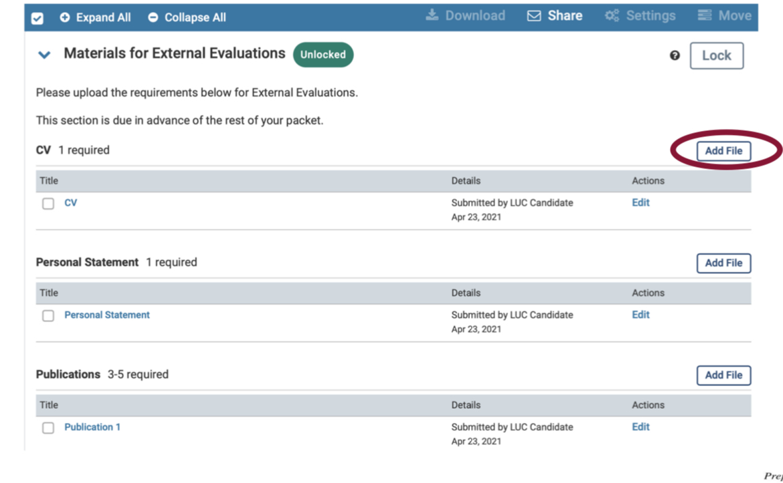
Step 2. Upload materials for external evaluations, tenure track faculty (if applicable; see your Guidelines for further information and deadlines)

Slide 7
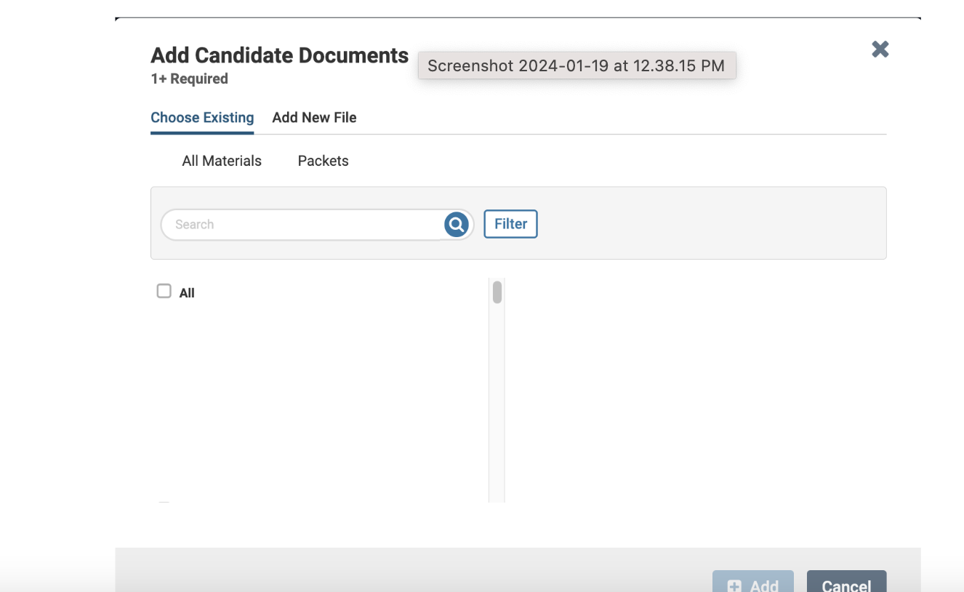
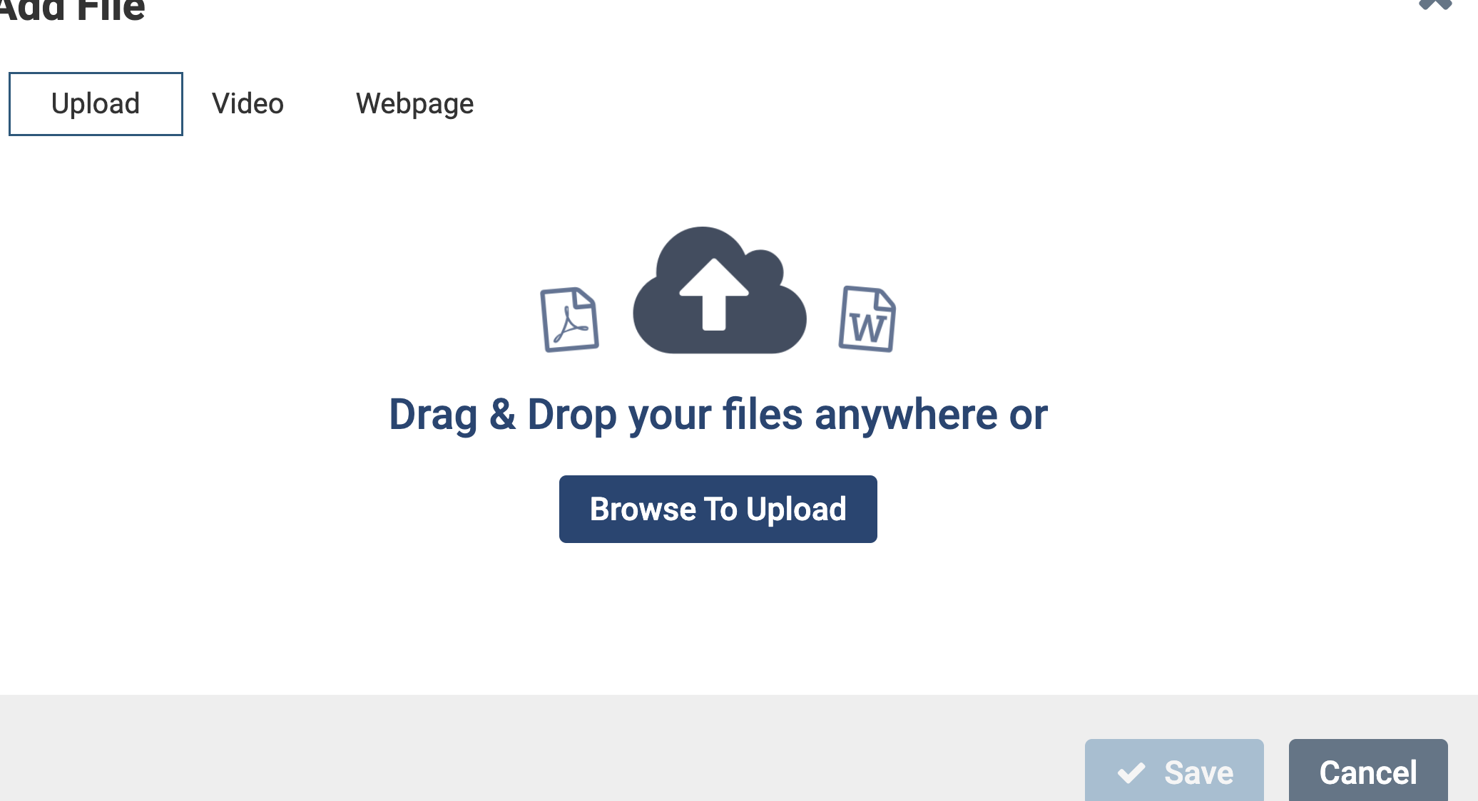
Uploading materials: files

Slide 8
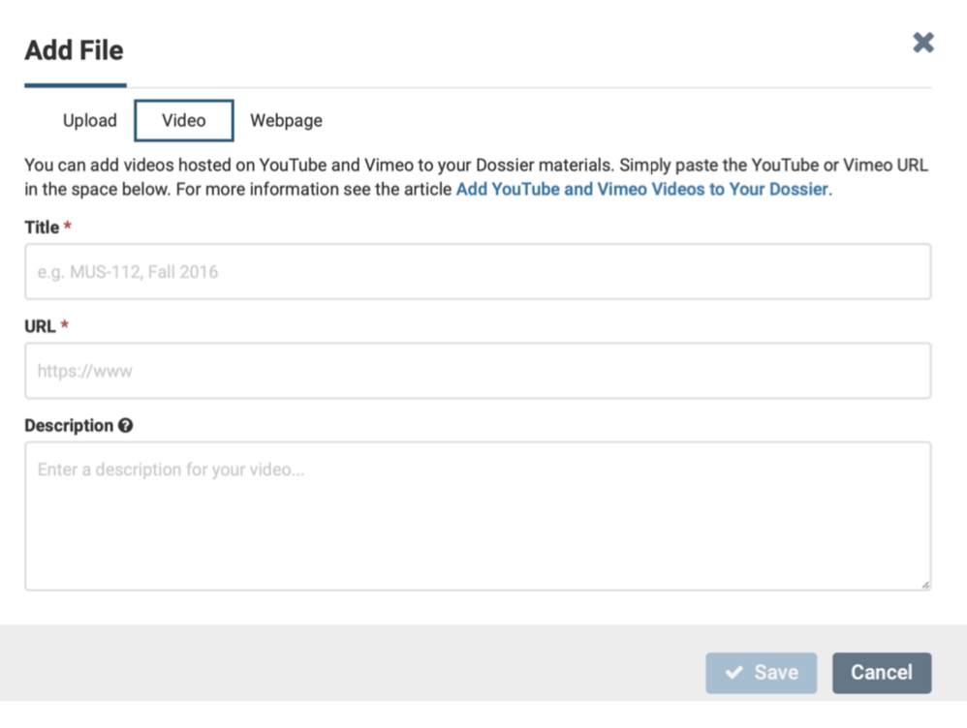
Uploading materials: link to online video

Slide 9
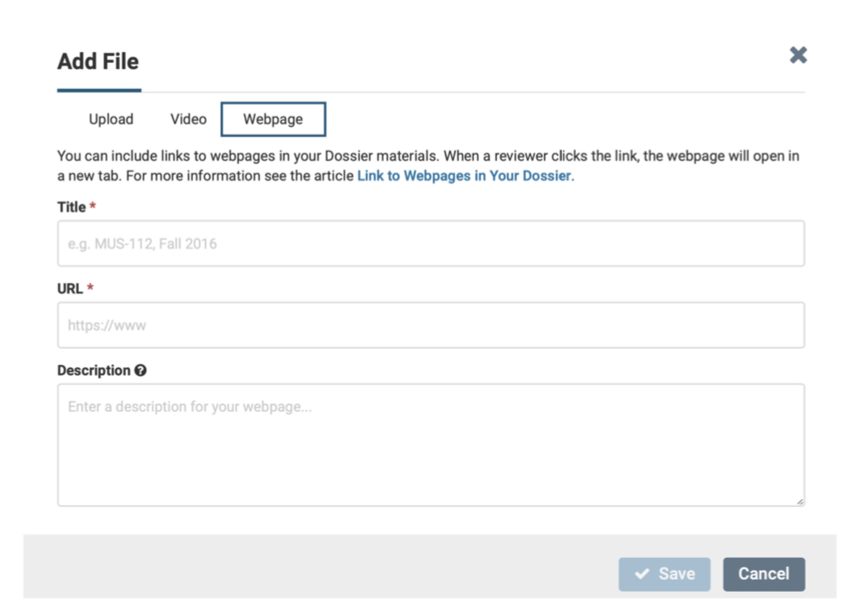
Uploading materials: link to webpage

Slide 10
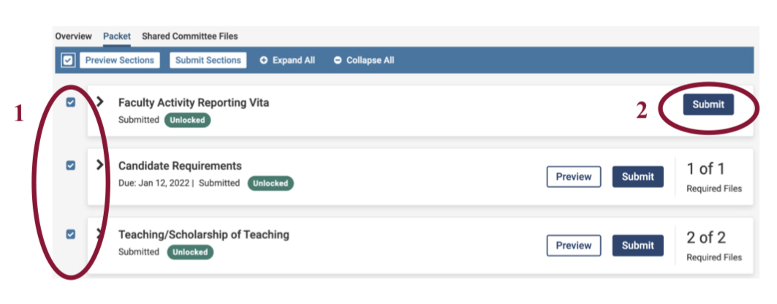
After uploading materials, don't forget to submit them. Click on the checkboxes, then click the Submit button.

Slide 11
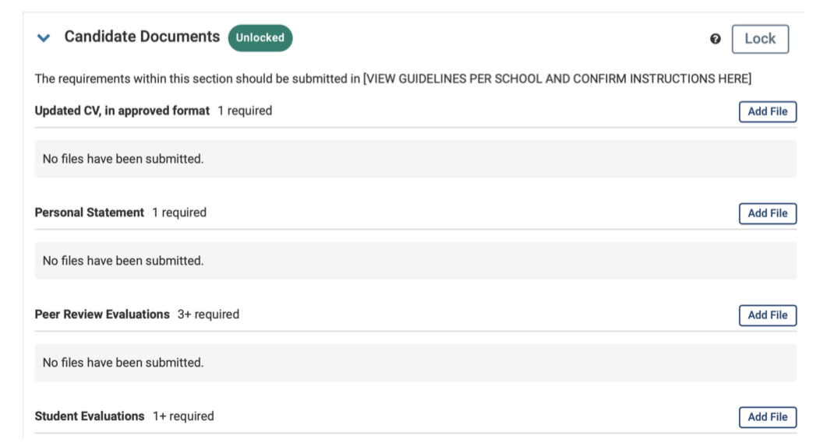
Step 3. Upload materials for internal review

Slide 12
Step 4. Celebrate submitting the packet!

Slide 13
Some Time Saving Tips for Preparing and Uploading Materials
(A) You can upload files to Interfolio Dossier at any point to collect files you will want to use in your P&T cases.
(B) If you have already done a promotion or review in Interfolio RPT, you can upload those packets to your new case.
(C) Gather and organize your files for promotion every year in one location to save time in the future.

Slide 14
What is Interfolio Dossier?
Interfolio Dossier is a free tool that helps scholars to collect, organize, and send out evidence of their academic excellence.
Any files you add to your Interfolio RPT packets automatically get uploaded to your Interfolio Dossier.
Documents uploaded to Interfolio Dossier are not automatically uploaded to your packets for your case.
Documents uploaded to F180 (faculty annual review) do not get added to Interfolio Dossier

Slide 15
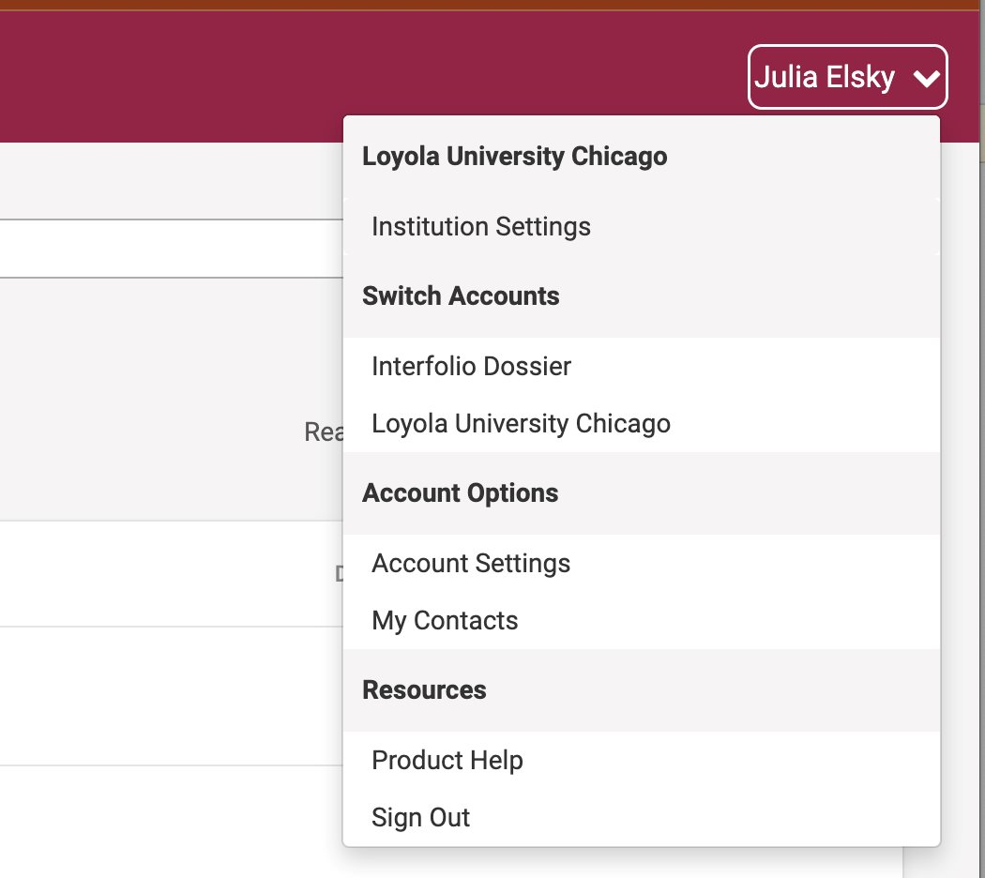
How do I access Interfolio Dossier
Log in to Interfolio
Click on your name in the upper right corner
Select “Interfolio Dossier”

Slide 16
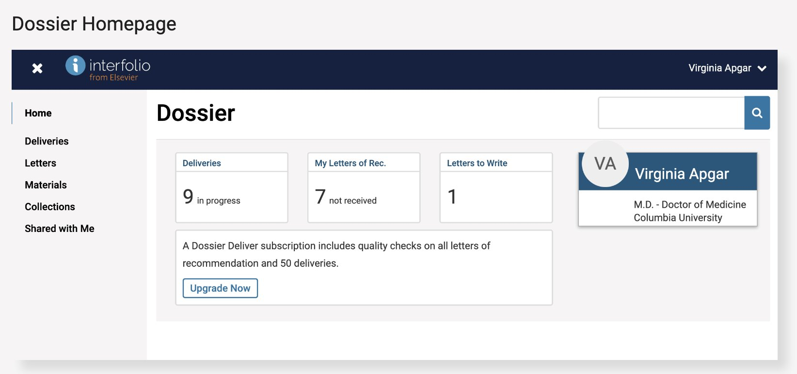
Materials: Upload and manage your materials to use in Interfolio RPT. For P&T, please ignore Deliveries, Letters, and Collections. You will not handle any external evaluations, and those all occur in Interfolio RPT.

Slide 17
(B) How to Add Materials from a Previous Packet

Slide 18
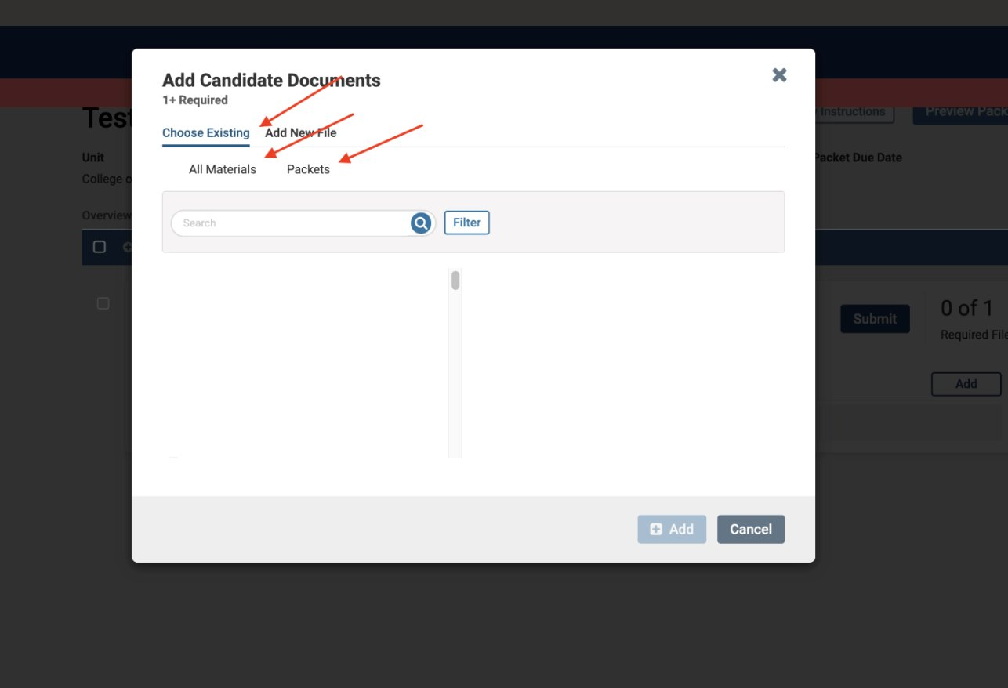
Select "Choose Existing" and then "Packets"

Slide 19
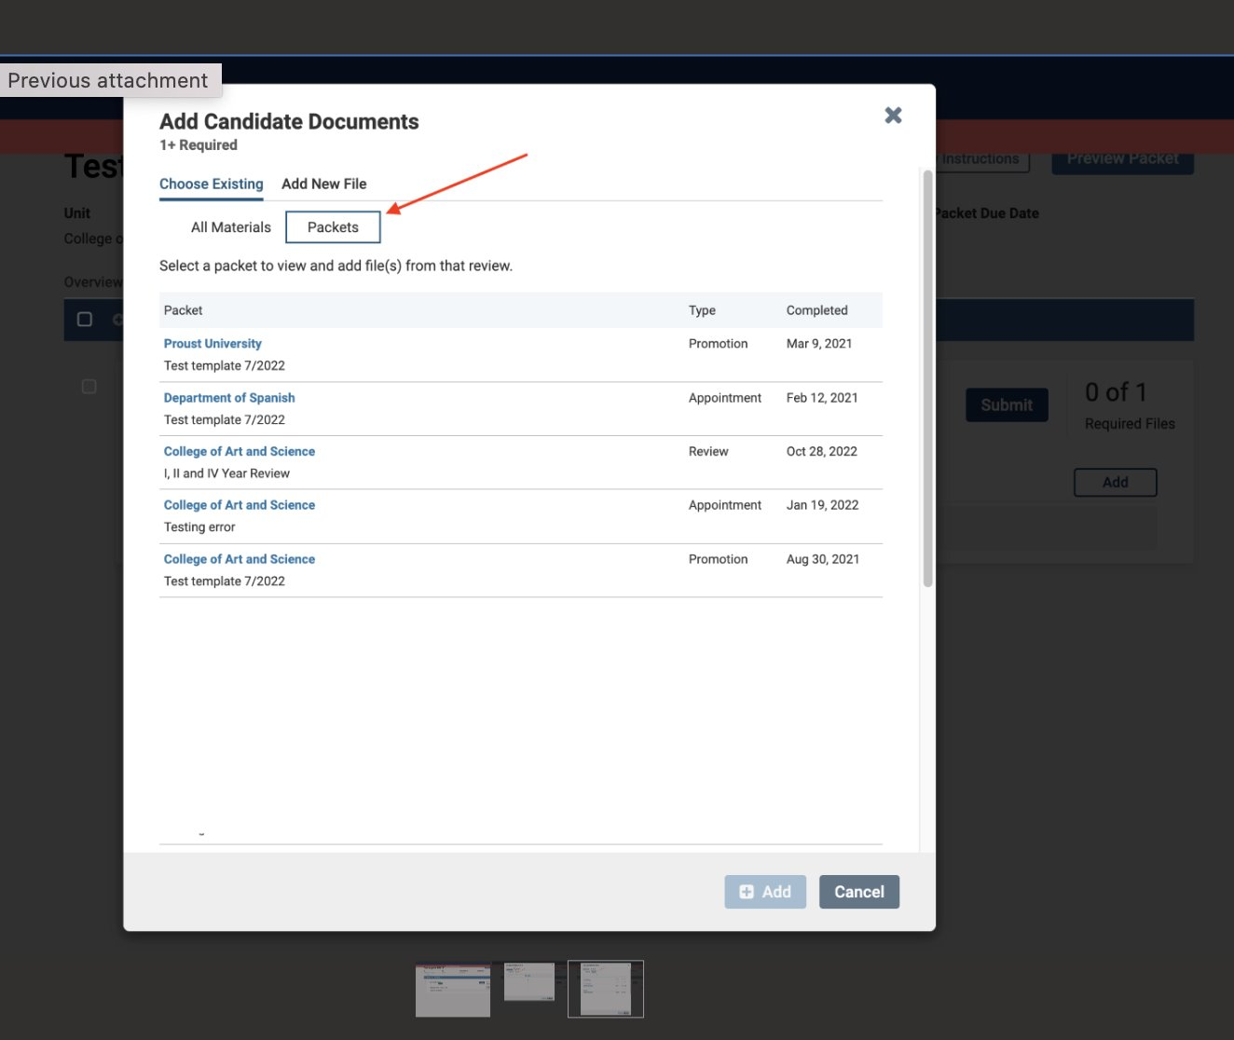
Your previous packets will be listed, and you will have the option to pull materials from them.

Slide 20
Interfolio RPT Support
For technical support, please contact Interfolio's Support team: help@Interfolio.com or (877) 997-8807
For questions about candidate cases, adding/managing users, and academic unit templates, please contact Loyola's Faculty Administration: Interfolio@luc.edu

Slide 21
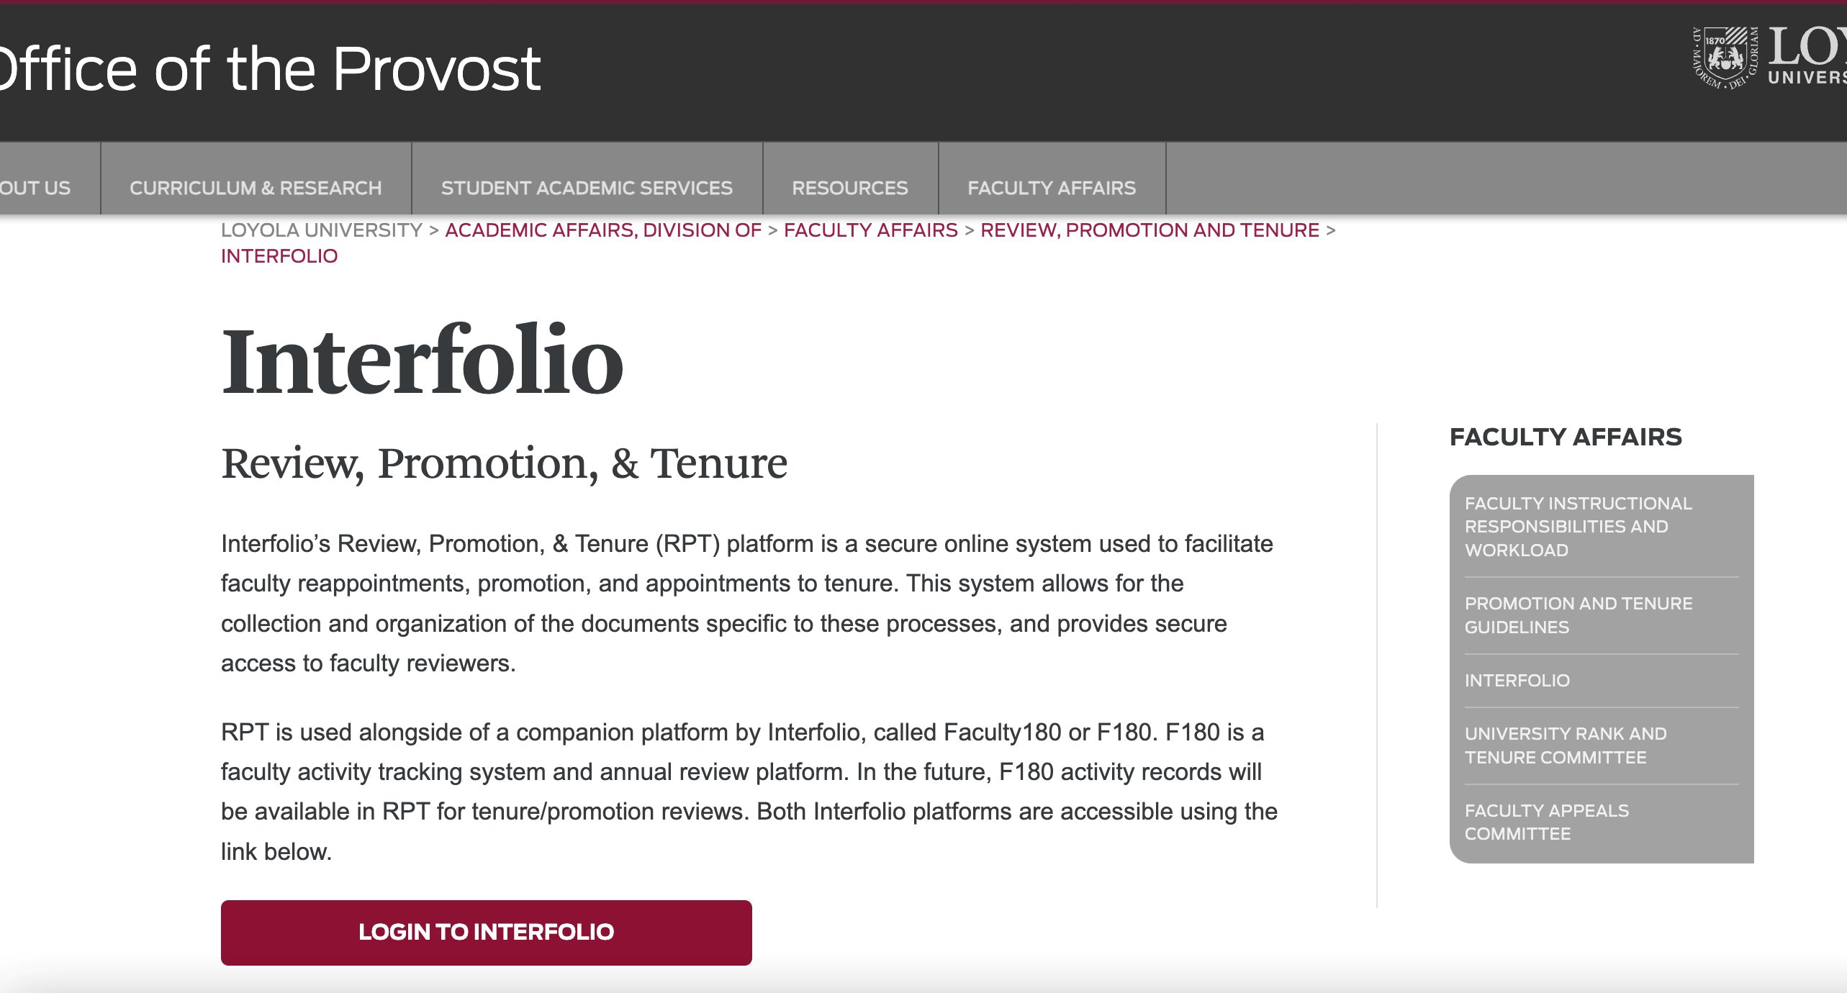
Loyola's Interfolio Support Website

Slide 22
Q & A
Answer
Consult your Guidelines and talk with your Academic Unit.
Faculty Affairs typically creates cases in late Spring/early summer, based on your College/School timeline. You will be notified via Interfolio RPT when a case is created for you.
If the question is about NTT vs TT promotions in Interfolio: there are distinct templates for different types of promotions.
Questions regarding Interfolio:
Do we need letters of recommendation from faculty from other universities? This is for NTT promotion.
When do we get notified if a case is created for us in Interfolio?
NTT to tenure

Slide 23
Q & A
Answer
Reviewers do not generate reports. Your materials will be viewable in the order of the sections you see, and your files within those sections appear in the order in which you uploaded them. You can preview your case before you submit it.
Questions regarding Interfolio:
Mostly my concerns have to do with the 'output'; that is, what the other side sees when they generate reports. I wish to have confidence that how I am entering data on my side will result in something clean for the reviewer.

Slide 24
Contacts
Michelle Pencyla, M.Ed.
Assistant Provost, Faculty Administration, Health Sciences Campus Office mpencyla@luc.edu
Julia Elsky, Ph.D.
Associate Director of Faculty Affairs;
Associate Professor, Department of Modern Languages & Literatures
jelsky@luc.edu or for Interfolio matters interfolio@luc.edu

